Slide 1

Font classification
A Computer Vision Project for OCR dataset
By
Hung Lo

Slide 2
Outline
Background knowledge
Dataset generation
Experiment
Conclusion

Slide 3

Font Classification Project with Vouched
● Identity proofing and verifying using AI
● classification
Notes:
Background knowledge
Dataset generation
Deep learning network
Experiment
Conclusion
Future work

Slide 4
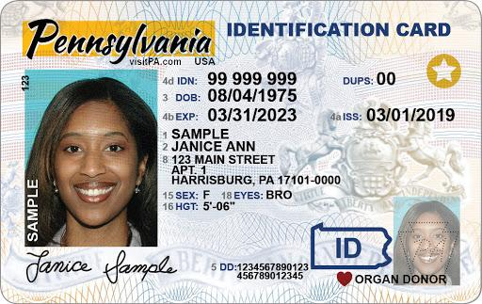
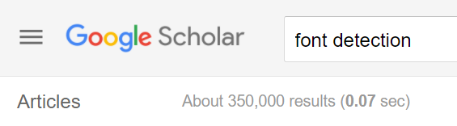

Background knowledge
Text detection is mature now
The important to distinguish Font types in the document

Slide 5
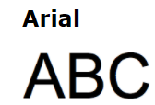
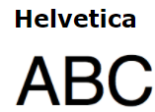
Challenge
The dataset for font classification
The font classification is difficult

Slide 6
Solution
Synthetic dataset
Deep learning

Slide 7
Generate Dataset

Slide 8
Dataset work pipeline
Collection fonts/ background image.
Overlay text on top of ID document background
Text: dark color ( RGB< 50)

Slide 9
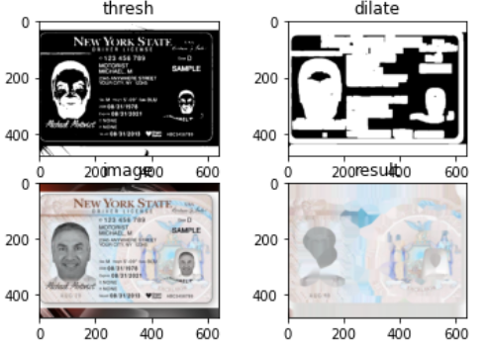
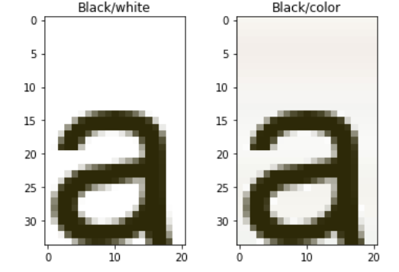

Algorithm

Slide 10
Experiment

Slide 11
Deep Learning Architecture
MobileNetV3
EfficientNet

Slide 12

Environment
Nvidia Tesla T4 and P100
RAM double than normal

Slide 13
Learning processing
Single char to word
White to color background
Small font types to Large font types
Fuzz background( blur/ noise)

Slide 14
History
winfont word with fuzz background(too difficult)
Single char with ArialFamily(4 diff. font)
Different Trial on Small/Large version

Slide 15
Milestone
Black char against white background
Black char against color background
Dark char against color background

Slide 16
Char training/test dataset
Fonts
Upper letter
Lower letter
image augmentation(only on training dataset)
Notes:
transforms.RandomHorizontalFlip(),
transforms.RandomRotation((0,60)),
transforms.Resize((224,224)),
transforms.ToTensor(),
transforms.Normalize([0.485, 0.456, 0.406], [0.229, 0.224, 0.225])

Slide 17




Font
Arial
Arial bd
Arial bi
Ariali
Notes:
Arial regular
Arial bold
Arial bold italic
Arial italic

Slide 18
Upper letter
Notes:
transforms.RandomHorizontalFlip(),
transforms.RandomRotation((0,60)),
transforms.Resize((224,224)),
transforms.ToTensor(),
transforms.Normalize([0.485, 0.456, 0.406], [0.229, 0.224, 0.225])

Slide 19
Lower letter
Notes:
Arial regular
Arial bold
Arial bold italic
Arial italic

Slide 20
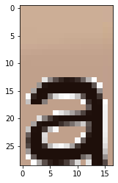
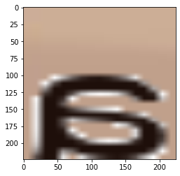
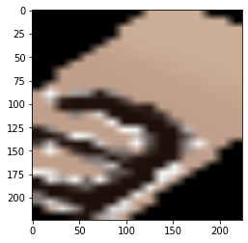
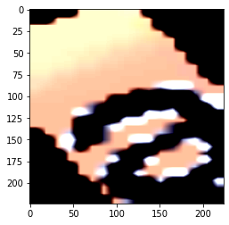
Image augmentation
Notes:
transforms.RandomHorizontalFlip(),
transforms.RandomRotation((0,60)),
transforms.Resize((224,224)),
transforms.ToTensor(),
transforms.Normalize([0.485, 0.456, 0.406], [0.229, 0.224, 0.225])

Slide 21
Experiment
Training dataset size: 1000=>2000=>10000=>30000
Model: mobilenet V3 small/large
Testing dataset size: 100=>200=>1000=>2000
Notes:
transforms.RandomHorizontalFlip(),
transforms.RandomRotation((0,60)),
transforms.Resize((224,224)),
transforms.ToTensor(),
transforms.Normalize([0.485, 0.456, 0.406], [0.229, 0.224, 0.225])

Slide 22
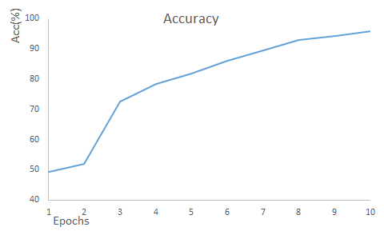
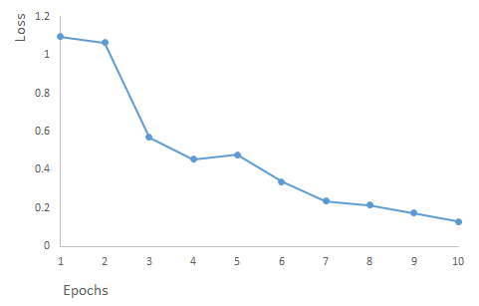
Outcome
Notes:
Data set from 30000 on four font
(7500 per font)
pretrained model with 1000

Slide 23
Experiment on Winfonts
Dataset size: 5000=>52000
Test size: 500=>5000
Currently 20 epochs, and the acc upto 60%

Slide 24
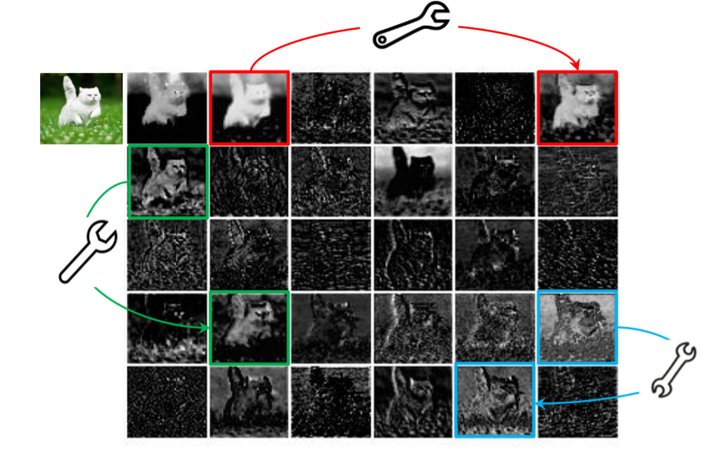
Experiment on GhostNet block
The reuse on the duplicate feature map

Slide 25
Future work
Experiment on Word
Win fonts( 20 types)

Slide 26

Word

Slide 27
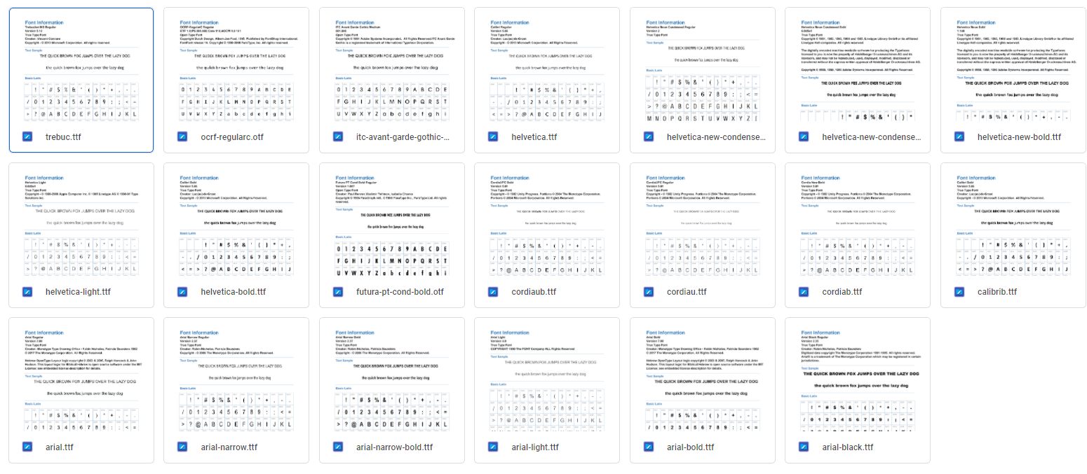
Winfont
Notes:
Expect every family need to 5000 sample for each font

Slide 28
Conclusion

Slide 29
Deliverables to the company (Vouched)
1. Python notebooks for font classification
2. Data files of authentic images I generated
3. The company can use the images to train their detection model

